Slide 1
Introduction to Simulation and Modeling

Slide 2
Manual Simulation
(Lecture 3)

Slide 3
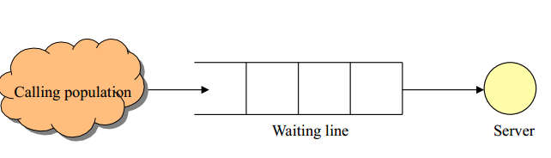
System Model

Slide 4
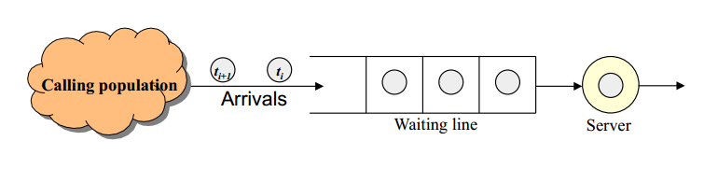
System Model

Slide 5

System Model
(Real World Scenario)

Slide 6
Manual Simulation
The following interarrival and service times were observed in a single-server, single-queue system:
Inter-arrival times (min): 1, 4, 2, 1, 8, 2, 4, 3
Service times (min): 2, 5, 4, 1, 3, 2, 1, 3
Calculate summary statistics for the time-average number in queue, average system time, based on 20 min

Slide 7
Solution
It is best to begin by organizing our data in a chart with headings for the number arrival, arrival time, begin-service time, end-service time, and total system time.
We can then populate the chart with our input data:

Slide 8
Arrival of entity one
The first event is the first arrival, which occurs at 1 min after the system starts.
Because there is no one else in the queue, and the server is idle, the customer can immediately seize the resource and begin the service time.
This means that the service time also begins 1 min after the system starts.
The service start is the second system event.
The service time for the first customer was 2 min. This means that the service end occurs at 3 min.
The service end is the third system event.
Note also that the total time that the customer was in the system is the service end or departure time of 3 min minus the arrival time of 1 min.

Slide 9

Arrival of entity one

Slide 10
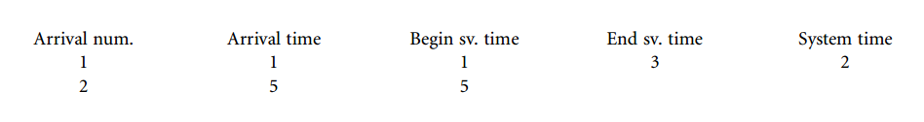
Arrival of entity Two
The fourth event that occurs is the arrival of the second entity.
Because there is no one in the queue, and the server is idle, this entity also goes directly to the server.

Slide 11
Arrival of entity Three
The second entity is scheduled to have a service time of 5 min. This means that the second entity’s service time would end at 10 min.
However, the inter-arrival time between the second and third entities is 2 min.
This results in the arrival of the third entity at 7 min.
Thus, the next event is not the end of the service of the second entity but the arrival in the system of the third entity.
Because the server is busy with the second entity, the third entity takes the first position in the queue

Slide 12
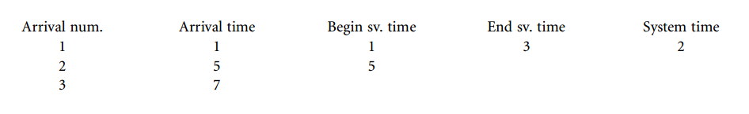
Arrival of entity Three

Slide 13
Arrival of entity Four
At this point two different things could occur.
The service time end for entity 2 could occur at 10 min, or another entity could arrive in the system before 10 min.
The interarrival time between the third and fourth entities is 1 min.
This means that the fourth entity arrives at 8 min.
This is before the service time ends for the second entity.
The fourth entity enters the queue behind the third entity so there are now two entities in the queue

Slide 14
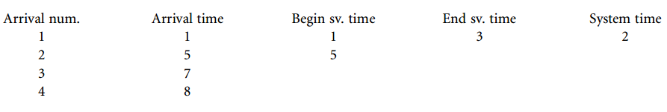
Arrival of entity Four

Slide 15
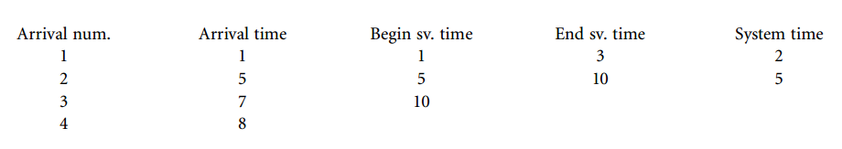
Service End of Second Entity
Now two other events could occur.
The service time for entity 2 could end at 10 min, or the fifth entity could arrive in the system.
As it turns out, the interarrival time for the fifth entity is 8 min.
This means that the service end for the second entity will be the next event.

Slide 16
Service End of Second Entity

Slide 17
System Time of Second Entity
As service end of second entity event occur so we can calculate the system time for the second entity in the same manner as the first entity.
Because the second entity did not wait in the queue before being serviced, its system time is the same as its service time.
Service end or departure time of entity minus the arrival time of entity

Slide 18
Serving of Entity 3
At 10 min a second event occurs.
Because entity 3 was waiting in the queue, as soon as entity 2 was finished, entity 3 immediately seized the resource at 10 min.
With entity 3 now being served, only entity 4 is now waiting in the queue.
Entity 3 has a service time of 4 min. This means that its service time will be completed at 14 min.
Because the interarrival time for entity 5 was 8 min, the service time for entity 3 will be completed before entity 5 arrives at 16 min

Slide 19
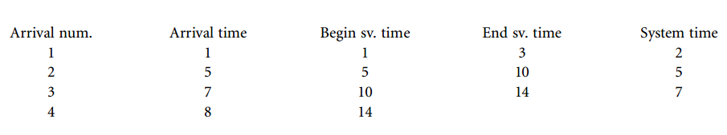
Serving of Entity 3

Slide 20
System time calculation for the third entity
The system time calculation for the third entity is slightly different
Entity 3 actually waited in the queue for 3 min So in this case, the system time is 14 min minus 7 min

Slide 21
Serving of Entity Four
Entity 4 was waiting in the queue when entity 3 finished, it immediately left the queue and seized the
server.
The queue now has no entities
The next event turns out to be the end of the service time for entity 4.
This is because entity four has a short service time of only 1 min.
Entity 4 also waited in the queue. The system time for entity four is
15 min minus 8 min = 7 min.

Slide 22
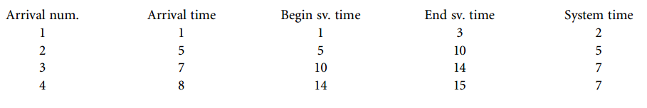
Serving of Entity Four

Slide 23
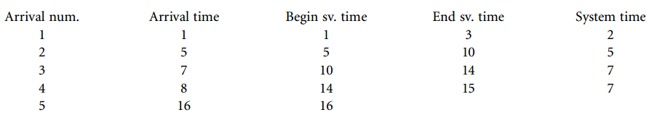
Arrival of Entity Five
Because the server is now idle at 15 min, the only event that can occur next is an arrival.
The next event is the arrival of entity 5 at 16 min.
No one is in the queue, so entity 5 immediately seizes the resource at 16 min.

Slide 24
Arrival of Entity Six
At 16 min, two different events could occur.
The service time for entity 5 could end, or entity 6 could arrive.
The interarrival time for entity 6 is 2 min.
The service time for entity 5 is 3 min.
This means that the next event is the arrival of entity 6 at 18 min.
The server is busy with entity 5, so entity 6 enters the queue.

Slide 25
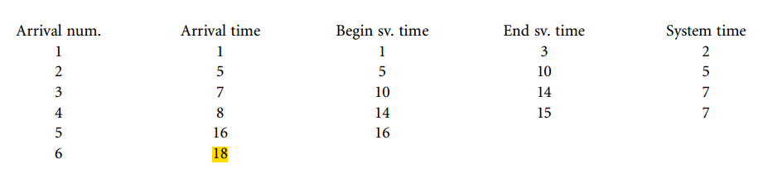
Arrival of Entity Six

Slide 26
Arrival of Entity Six
The interarrival time for entity 7 is 4 min for an arrival at 22 min, whereas the service end for entity 5 is 19 min.
Because no more entities can arrive before 22 min, the next event is the service end for entity 6.
The system time can be calculated for entity 5 as 3 min.
Because entity 6 is waiting in the queue, it can immediately seize the resource at 19 min.

Slide 27
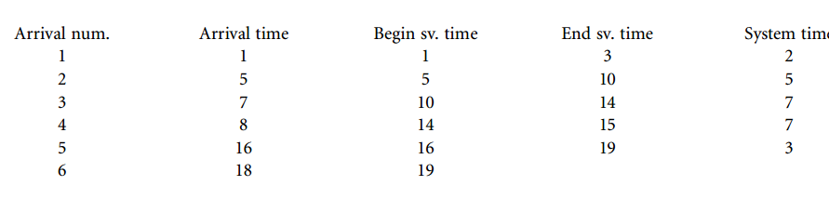
System time of Entity 5 and serving of Entity 6

Slide 28
Arrival of Entity Seven Service End of six
The next event can be either the arrival of entity 7 or the service end for entity 6.
The interarrival time for entity 7 is 4 min for an arrival at 22 min.
The service time of entity 6 is 2 min.
This would make the next event be the end of service for entity 6 at 21 min.

Slide 29
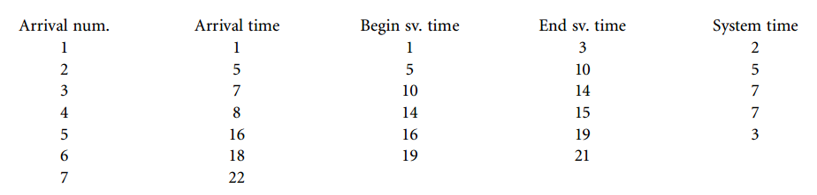
Arrival of Entity Seven Service End of six

Slide 30
Note
We actually specified in the model that we wanted to calculate the summary statistics based on 20 min.
This means that we do not need to worry about the arrival of entity 7 at 22 min.
We also do not need to worry about the end of service for entity 6 at 21 min

Slide 31
Output Calculations
Our event list is now complete, and we can turn our attention to calculating the output measures of performance

Slide 32
System time of the entities
At the time 20, only five different customers have exited the system.
We do not need to be concerned about any entities still in the system when we are calculating an observational type of measure such as system time.
We can calculate the average system time by summing all of the individual system times and dividing by 5. Thus, the average system time for all of the entities that were processed through the system was 4.8 min.

Slide 33

System time of the entities
Thus, the average system time for all of the entities that were processed through the system was 4.8 min.

Slide 34

Time Average Number in Queue Calculations
For entity 1 at 1 min and entity 2 at 5 min, service is available immediately.
When entity 3 arrives at 7 min, it must wait in line.
Entity 3 waits in line until entity 4 arrives at 8 min. This means that for 1 min between 7 and 8 min there was one entity in line:

Slide 35

Time Average Number in Queue Calculations
The next relevant event is the end of service of entity 2 at 10 min.
This means that two entities, entities 3 and 4, waited in the queue for the period between 8 and 10 min:

Slide 36

Time Average Number in Queue Calculations
At 10 min there is only one entity, entity 4, in the queue.
The next relevant event is the service end of entity 3 at 14 min.
This means that entity 4 waited in the queue alone between 10 and 14 min

Slide 37

Time Average Number in Queue Calculations
At 14 min there is no one waiting in the queue.
The next event is the arrival of entity 5 at 16 min.
Because there is no one in the queue, and the server is idle, entity 5 does not have any queue time.
The next event that occurs is the arrival of entity 6 at 18 min.
The server is busy, so entity 6 enters the queue.
The next relevant event is the end of service time for entity 5 at 19 min.
This event causes entity 6 to leave the queue. Entity 6 was the single entity in the queue for 1 min:

Slide 38
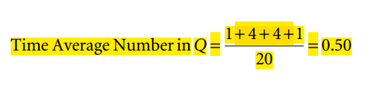
Time Average Number in Queue Calculations
When entity 6 leaves the queue, there are no other entities in the queue.
The next entity does not arrive until 22 min.
This means that for the remainder of the simulation, up to 20 min, the queue is 0.
The average time in queue can now be calculated by summing the periods of time that entities were waiting in the queue and dividing by the simulation time:

Slide 39
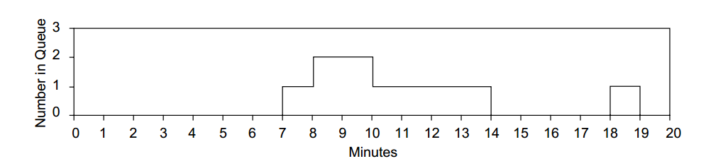
Time Average Number in Queue Calculations
The graphic representation of the time average number in queue is illustrated:

Slide 40

Average Resource Utilization Calculations
The average utilization calculations are somewhat easier to compute because the single resource can be only idle or busy
The relevant resource utilization events begin at 1 min.
When entity 1 arrives and finds the queue empty and the server idle. So between 0 and 1 min, the utilization rate is 0:

Slide 41

Average Resource Utilization Calculations
The resource remains busy until the end of the service time for entity 1.
This occurs at 3 min. This area is calculated by:

Slide 42

Average Resource Utilization Calculations
At 3 min, there are no entities waiting in the queue.
The next resource event occurs at 5 min, when entity 2 arrives to an empty queue and an idle server

Slide 43

Average Resource Utilization Calculations
The server stays busy with entity 2 until the end of entity 2’s service time at 10 min:
At the end of entity 2’s service time, entity 3 is already waiting in the queue. Entity 3 immediately seizes the resource for its service time of 4 min, until 14 min into the simulation:

Slide 44


Average Resource Utilization Calculations
At 15 min, there are no entities waiting in the queue. The next entity arrives at 16 min:
At 16 min, entity 5 arrives and immediately seizes the resource.
Entity 5 uses the resource for 3 min, until 19 min into the simulation:

Slide 45

Average Resource Utilization Calculations
At 19 min, entity 6 is already waiting in the queue.
It immediately seizes the resource at 19 min and keeps it past our cut-off time of 20 min.
The average utilization of the single resource can be calculated to be an 80% utilization rate:

Slide 46
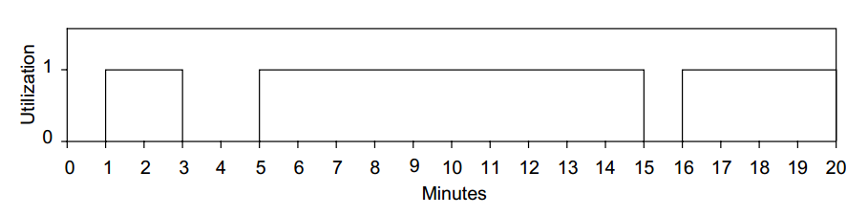
Average Resource Utilization Calculations

Slide 47
Summary
Any Questions?

